Slide 1
Benton Harbor Drinking water study

Slide 2
Background
On September 9 ,2021 EPA was petitioned by Drinking Water advocacy groups to conduct several Water Studies : priority on evaluation of effectiveness of water filters provided by Berrien County
EPA Water Division, Office of Research and Development along with EGLE and MDHHS requested response organization support to implement Water Studies in desired timeframe ( before cold weather and prior to Holidays)
Challenges:
  Multiple agencies
  High Pandemic conditions in community
  High Covid Positivity rates in mid-20% range

Slide 3
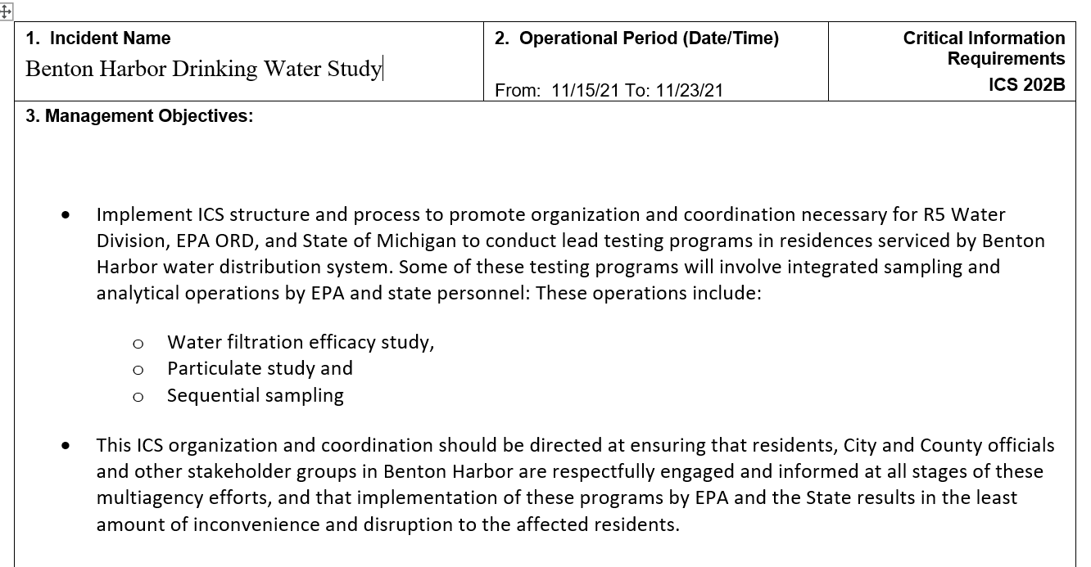

Slide 4
Hybrid Response organization
November 6-December 17,2022
Virtual and Remote
Field

Slide 5
Benton Harbor Drinking Water Study
ICS 207 – IMT Organization Chart
06 Dec 2021 0800 to 17 Dec 2021 1700
Date: 01 December 2021
Virtual and Remote
Unified Command
IC Dollhopf / Dep-IC Kimble & Durno EPA
Gerald Tiernan MDHHS
Jeffery Sims Berrien County HD
Brandon Onan EGLE
RIC
Tera Fong EPA
Safety Officer
Shanna Horvatin EPA
Assistant Safety Officer
Keith Fusinski EPA
Data Support Coordinator
Jason Sewell EPA
EOC
Mike Bryant EPA
Mary Gelder EPA
Public Information
Phillipa Cannon EPA
Chris Finch MDHHS
COVID Safety
Jackie Cole EPA
Melissa Millerick-Mays MDHHS
Liaison Officer
Tom Mendez EPA
Operations Section
Andy Maguire EPA
Candice Bauer EPA
Lisa Quiggle MDHHS
Aaron Ward MDHHS
Planning Section
Steve Renninger EPA
Finance Section
Rick Hackley EPA
Hope Bartlett MDHHS
Logistics Section
Jeff Borseth EPA
Kristine Arvizu MDHHS
Planning/Ops
Steve Wolfe EPA
See Planning 207
Supplies Unit
Rob Snyder CRL
Jennifer Tully ORD
Peggy Donnelly WD
Deborah Roose ORD
See OPS 207

Slide 6
Benton Harbor Drinking Water Study
ICS 207 – Planning Organization Chart
06 Dec 2021 0800 to 17 Dec 2021 1700
Date: 01 December 2021
Virtual and Remote
Planning Section
Steve Renninger EPA
Deputy Planning Section
Paul Ruesch EPA
Jacob Hassan EPA
Betsy Nightingale EPA
Environmental Unit
Jason Sewell EPA
Val Bosscher WD
Data Management Unit
Jason Sewell EPA
Rob Kondreck EPA
Stuart Eddy MDHHS
Mapping/GIS Unit
Eric Holbus EPA
Lucy Stanfield EPA
Situation Unit
Janien Turner EPA
Brandon Pursel EPA
Resource Unit
Jeff Wawczak EPA
Alicia Brown EPA
Documentation Unit
Don Schwer EPA
See ENVL Unit 207
See ENVL Unit 207

Slide 7
Benton Harbor Drinking Water Study
ICS 207 – OPS Organization Chart
06 Dec 2021 0800 to 17 Dec 2021 1700
Date: 02 December 2021
Field
Operations
Andy Maguire EPA
Deputy Operations
Candice Bauer EPA
Lisa Quiggle MDHHS
Aaron Ward MDHHS
Technical Specialist
Jonathan Burian WD
Sampling Branch
Peg Donnelly WD
Joan Rogers ECAD
Tony Pavone MDHHS
Field Laboratory Branch
Peg Donnelly WD
Joan Rogers ECAD
Laboratory Branch
Heather Shoven CRL
Jonathan Pressman ORD
Community Involvement Branch
Diane Russell EPA
CarTyea Mathies MDHHS
Gina Campuzano, Cheryl Vaccarello TT
Courier
Margo Carrothers EPA
Fred Bartman EPA
Analytical Group
Rob Snyder CRL
Steve Harmon ORD
Amanda Wroble CRL
Heather Shoven CRL
(9) EPA CRL
Filter Installation Strike Team
(1) EPA
(1) MDHHS/MSG
Scheduling & Sampling Support Group
Sue Manente MDHHS
Diane Russell EPA
(5) EPA CRS
Team 1
Mostafa Noureldin EPA
Michelle Kerr EPA
Rapid Filter Screening Group
Sequential Sampling /
Particulate Group
Outreach Group
Diane Russell EPA
Regina Strong EGLE
Lakecia Powell-Denson MDHHS
Team 1
Clare Sheib-Feeley EPA
Alex Flevarakis EPA
Kevin Kasischke MDHHS
Team 3
Mike DeLong MSG
Cheryl Burdett EPA
Kevin Gaughan EPA
Results Communication Group
Tom Mendez WD
Sam Blazey WD
Kris Donaldson EGLE
Isaac Clark MDHHS
Team 2
Mari Nord EPA
John Nguywen EPA
Frank Schenkhuizen MDHHS
Team 4
Jodie Opie EPA
Jessica Bankey MSG
Rabia Azam MSG

Slide 8
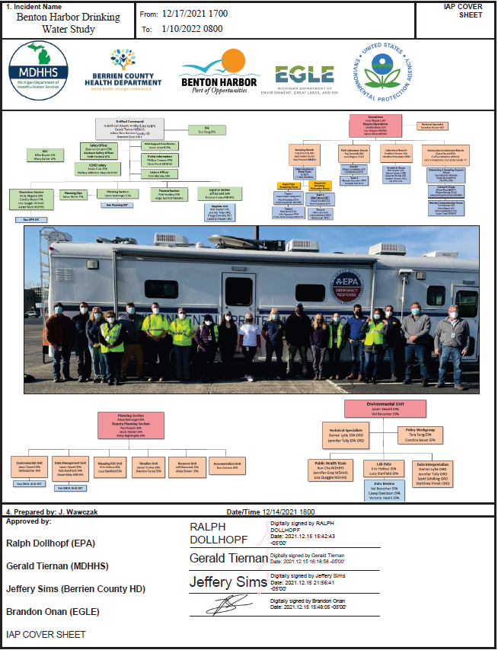
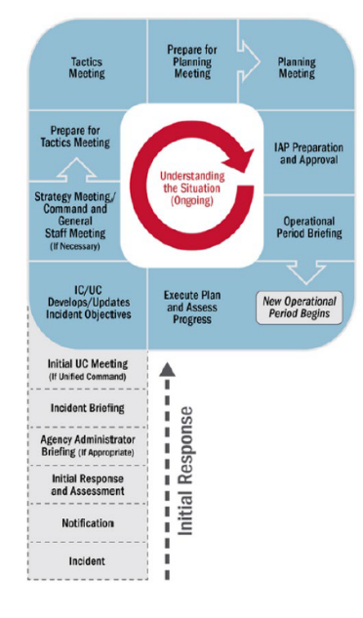
OPs Briefing
Conducted at the beginning of each operational period
Presents IAP to all supervisors of tactical resources/operations
30 min

Slide 9
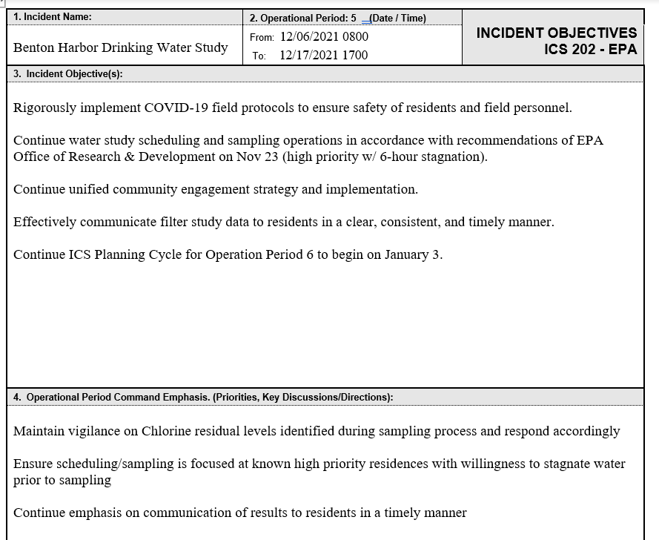
OP5

Slide 10
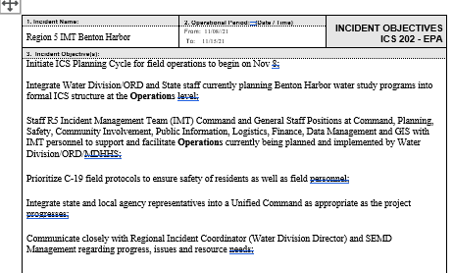
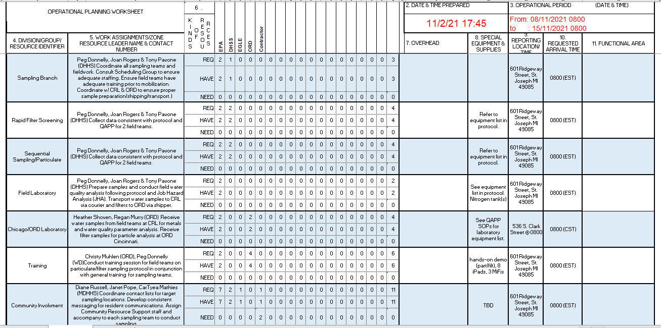
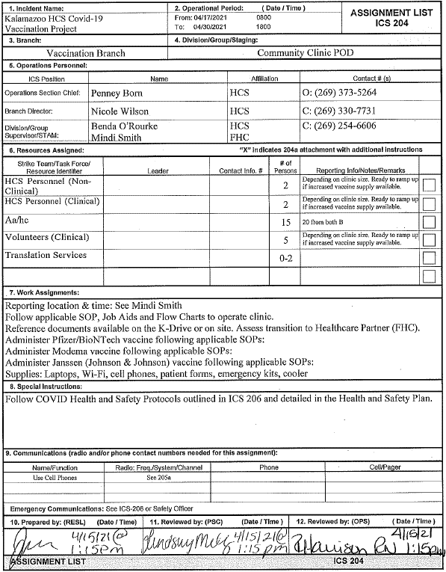
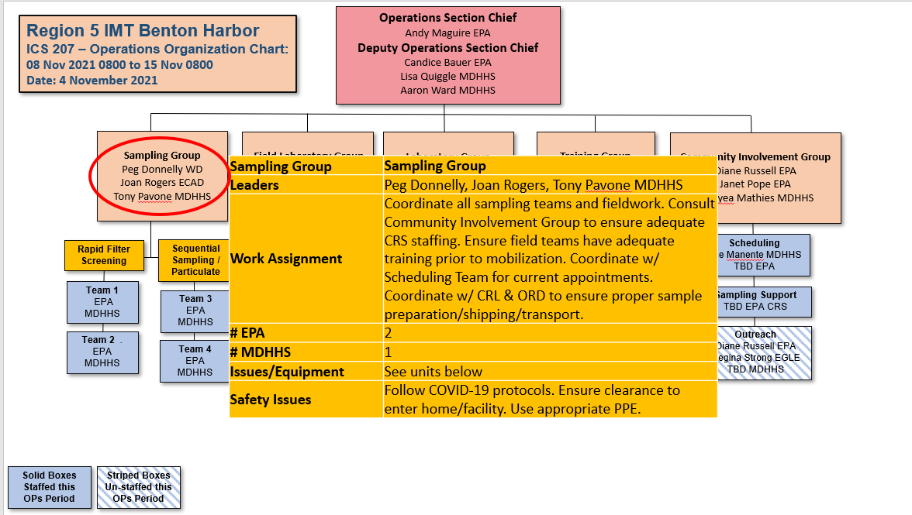
CGS Meeting: 202 Objectives
Tactics Meeting: 215 Ops Planning Worksheet/215A
IAP: 204 Assignment List
Planning Meeting: 215 Hybrid

Slide 11
Benton Harbor Drinking Water Study
ICS 207 – OPS Organization Chart
06 Dec 2021 0800 to 17 Dec 2021 1700
Date: 02 December 2021
Operations
Andy Maguire EPA
Deputy Operations
Candice Bauer EPA
Lisa Quiggle MDHHS
Aaron Ward MDHHS
Technical Specialist
Jonathan Burian WD
Sampling Branch
Peg Donnelly WD
Joan Rogers ECAD
Tony Pavone MDHHS
Field Laboratory Branch
Peg Donnelly WD
Joan Rogers ECAD
Laboratory Branch
Heather Shoven CRL
Jonathan Pressman ORD
Community Involvement Branch
Diane Russell EPA
CarTyea Mathies MDHHS
Gina Campuzano, Cheryl Vaccarello TT
Sampling Branch | Sampling Branch
Leaders | Peg Donnelly & Joan Rogers EPA, Tony Pavone MDHHS
Work Assignment | Coordinate all sampling teams and fieldwork. Consult Community Involvement Group to ensure adequate CRS staffing. Coordinate w/ Scheduling Team for current appointments. Coordinate w/ CRL & ORD to ensure proper sample preparation/shipping/transport. Provide training to incoming/new sampling personnel. Ensure reporting of low Cl detections per EGLE protocol.
# EPA | 2
# MDHHS | 1
Issues/Equipment | See units below
Safety Issues | Follow COVID-19 protocols. Ensure clearance to enter home/facility. Use appropriate PPE.
Courier
Margo Carrothers EPA
Fred Bartman EPA
Analytical Group
Rob Snyder CRL
Steve Harmon ORD
Amanda Wroble CRL
Heather Shoven CRL
(9) EPA CRL
Filter Installation Strike Team
(1) EPA
(1) MDHHS/MSG
Scheduling & Sampling Support Group
Sue Manente MDHHS
Diane Russell EPA
(5) EPA CRS
Team 1
Mostafa Noureldin EPA
Michelle Kerr EPA
Rapid Filter Screening Group
Sequential Sampling /
Particulate Group
Outreach Group
Diane Russell EPA
Regina Strong EGLE
Lakecia Powell-Denson MDHHS
Team 1
Clare Sheib-Feeley EPA
Alex Flevarakis EPA
Kevin Kasischke MDHHS
Team 3
Mike DeLong MSG
Cheryl Burdett EPA
Kevin Gaughan EPA
Results Communication Group
Tom Mendez WD
Sam Blazey WD
Kris Donaldson EGLE
Isaac Clark MDHHS
Team 2
Mari Nord EPA
John Nguywen EPA
Frank Schenkhuizen MDHHS
Team 4
Jodie Opie EPA
Jessica Bankey MSG
Rabia Azam MSG

Slide 12
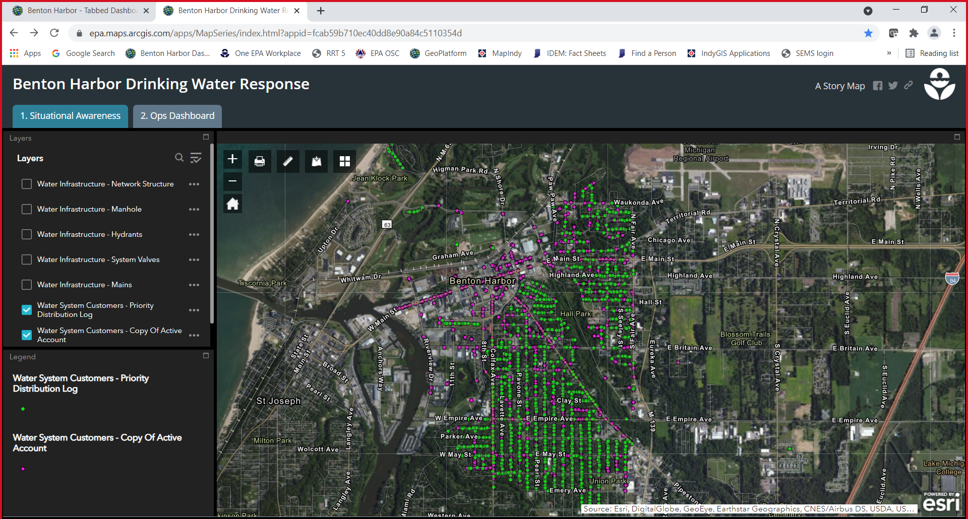
Situation Viewer/Dashboard

Slide 13
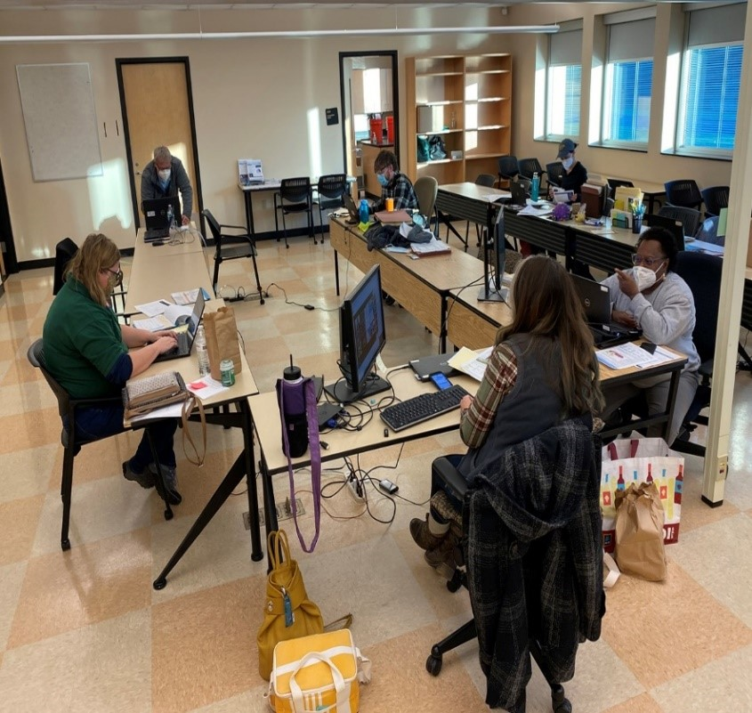
Community Engagement
Scheduling
230 homes

Slide 14
Sampling
2000 samples

Slide 15
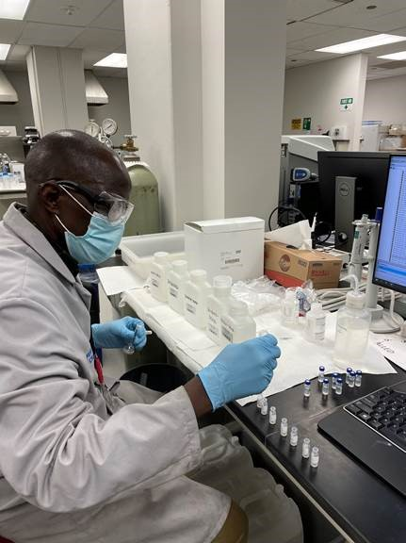
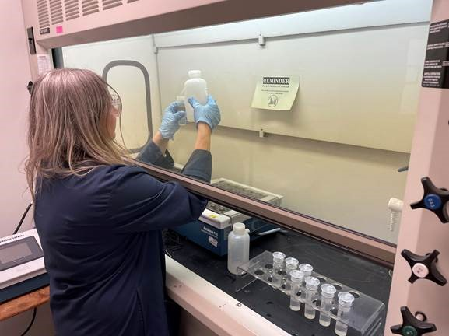
Laboratory Analysis
4000 analyses

Slide 16
Results
“We know the technical solution to this problem.
This response will be about how well we communicate.”

Slide 17
Findings from the Drinking Water Study
Filter Study
  Filters are working as expected to reduce lead in drinking water
Sequential Study
  On-Going.
  Clear picture of lead sources in interior plumbing and service lines
  Some analysis are indicating potential issues with plumbing in homes
Particle Study
  No evidence of nano-particle concerns
Community
  Need for filter education and services support

Slide 18
https://www.epa.gov/mi/benton-harbor-drinking-water

Slide 19
https://www.epa.gov/mi/benton-harbor-michigan-drinking-water-study-results

Slide 20
https://www.epa.gov/system/files/documents/2022-03/benton-harbor-water-filter_final.pdf

